Slide 1


CryptoParty DFW is now...
Open Technology Workshops

Slide 2
Open Technology Workshops
APPLICATIONS
Using Free and Open Source software

Slide 3
Open Technology Workshops
What is Open Source?
Open Source | Closed Source
You can access, modify, and distribute the source code. | No access to source code and the software cannot be legally copied.
The price is free, however “freemium” products exist. | Usually costs money, but can also be free.
Development driven by individual, community, or corporate efforts. (A note about funding) | Entirely developed by company.
Limited support. | Companies usually have dedicated support teams.
Software is security-tested more often by virtue of the code being public. | Must rely on company to institute fixes.
Notes:
Open source means that the source code is available to the public and has usually has a permissive license for use. This contrasts with closed source software that has a restrictive license and the source code is not available.
Sources:
https://www.turing.com/blog/open-source-vs-commercial-software-license/#:~:text=Users
%20of%20open%20source%20software,to%20users%20without%20upfront%20costs.
https://www.geeksforgeeks.org/difference-between-open-source-software-and-commercial-software/#

Slide 4
Open Technology Workshops
Benefits of Open Source
Benefits to you
  It’s FREE!
  Lower barrier-to-entry than with expensive commercial software
  FOSS doesn’t violate your privacy (and this can be proven by looking at the source code!)
  Lesser dependence on proprietary ecosystems and formats
Wider impact
  You’re shifting the market balance away from commercial vendors.
  You’re elevating software that has the benefit of thousands of global developers who can vet the code and each others’ work.
Notes:
Wider impact
You’re taking the market balance away from commercial vendors.
You’re shifting trust from one group of developers at a company to a world-wide network of contributors who can vouch for the security of the code.
You’re using software that’s accessible to all, and reduce barriers to entry to gain knowledge and experience.

Slide 5





Open Technology Workshops
FOSS Alternatives
Office Suites and Notes
LibreOffice, OnlyOffice, Thunderbird, Sumatra PDF, Trillium, QownNotes
Web Browsers
Firefox, Chromium
Communications Tools
Thunderbird, Jitsi, RustDesk
Imaging Tools
GIMP, Inkscape, Krita
Multimedia Software
VLC Media Player
Watch Out!
Some free software like Google Chrome has an open core and many closed-source components. However, you can find purely open source versions like Chromium.

Slide 6


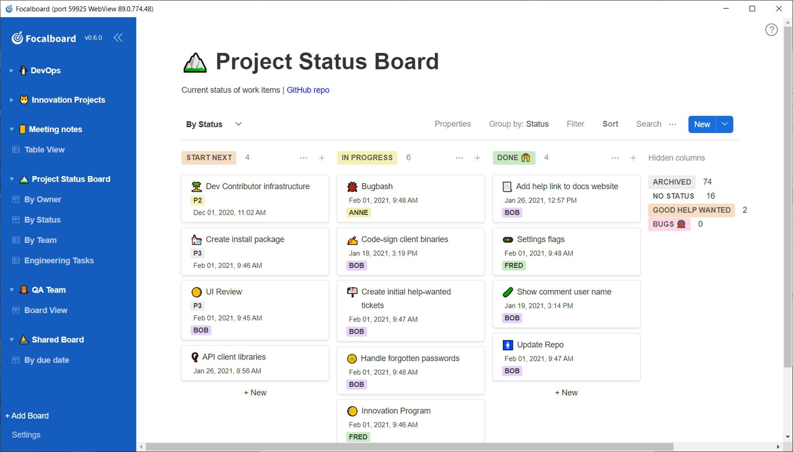

Open Technology Workshops
Business Applications
Some of these solutions might require administrator skills to set up, but those are intended for teams or organizations.
Cloud Storage/Sync
Nextcloud, Syncthing
Collaboration
Mattermost Jitsi
Kanban Boards
Focalboard
Development
VS Codium, Notepad++, GitLab

Slide 7
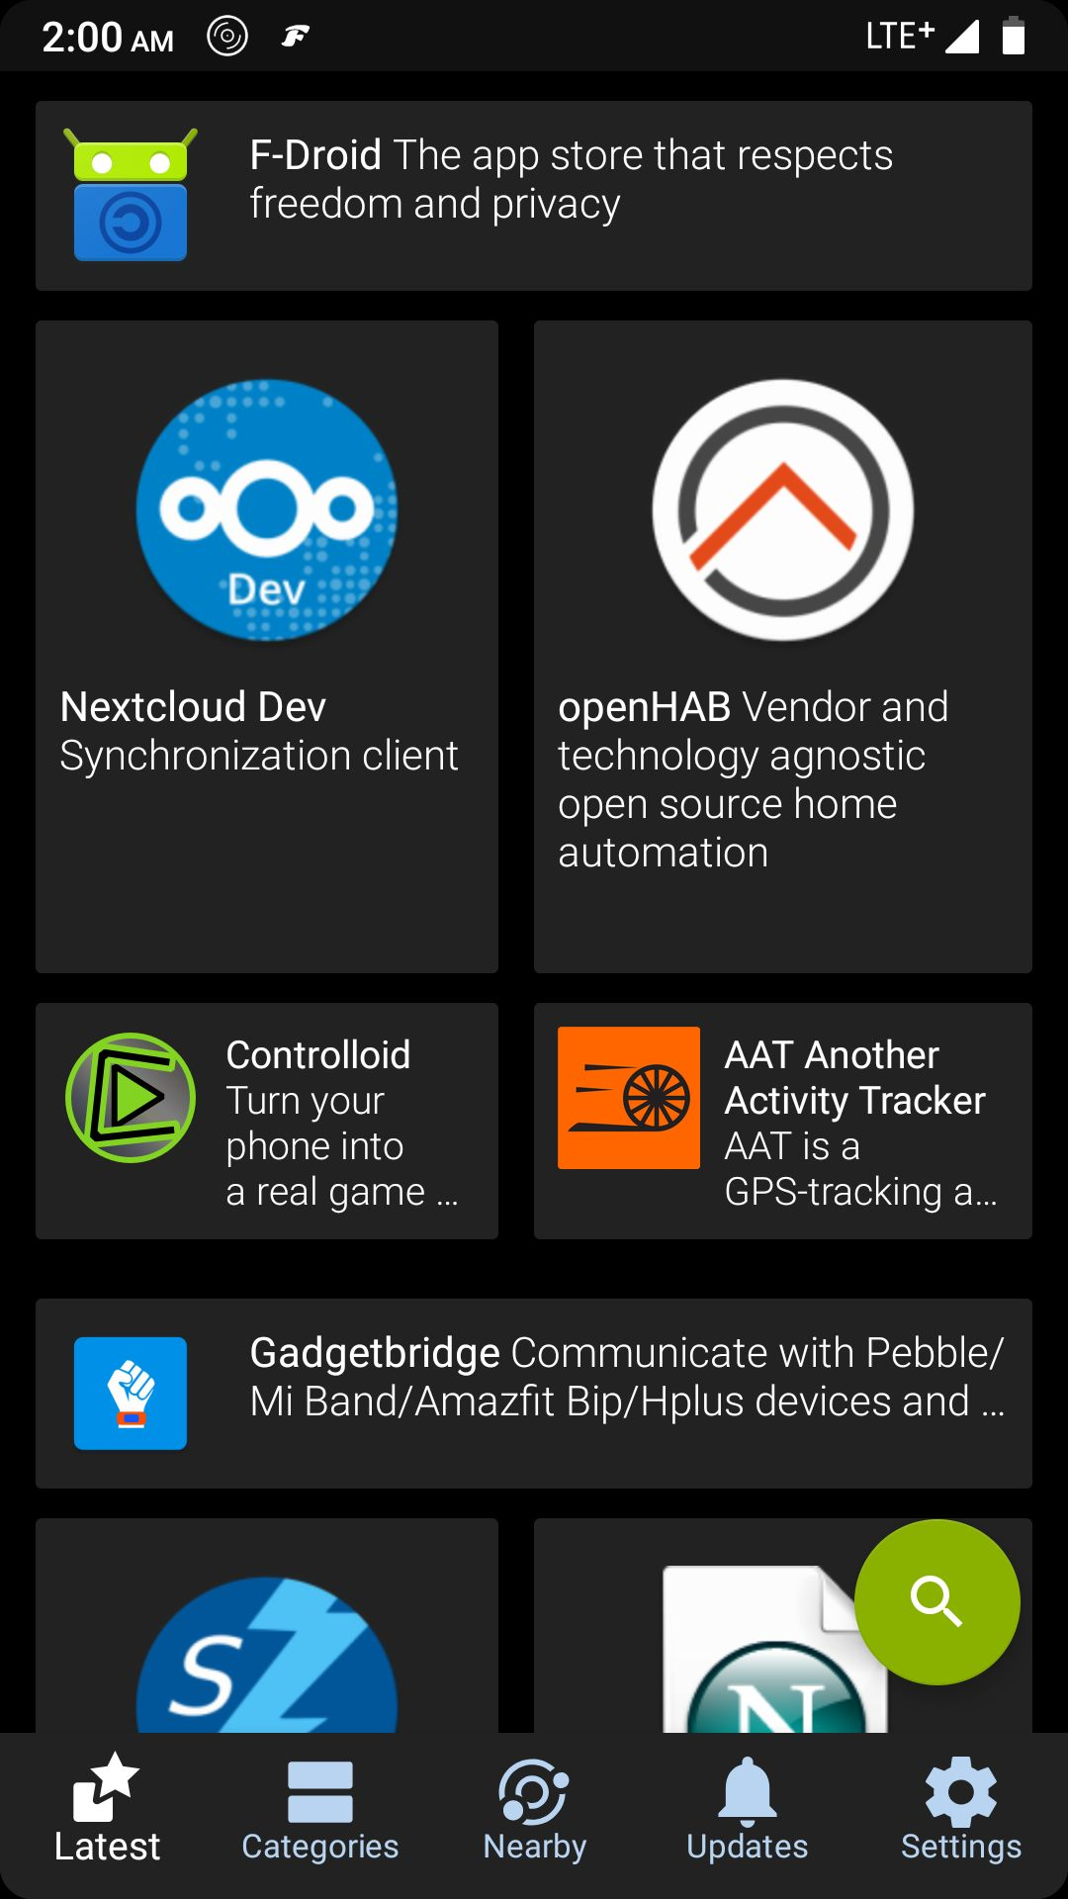
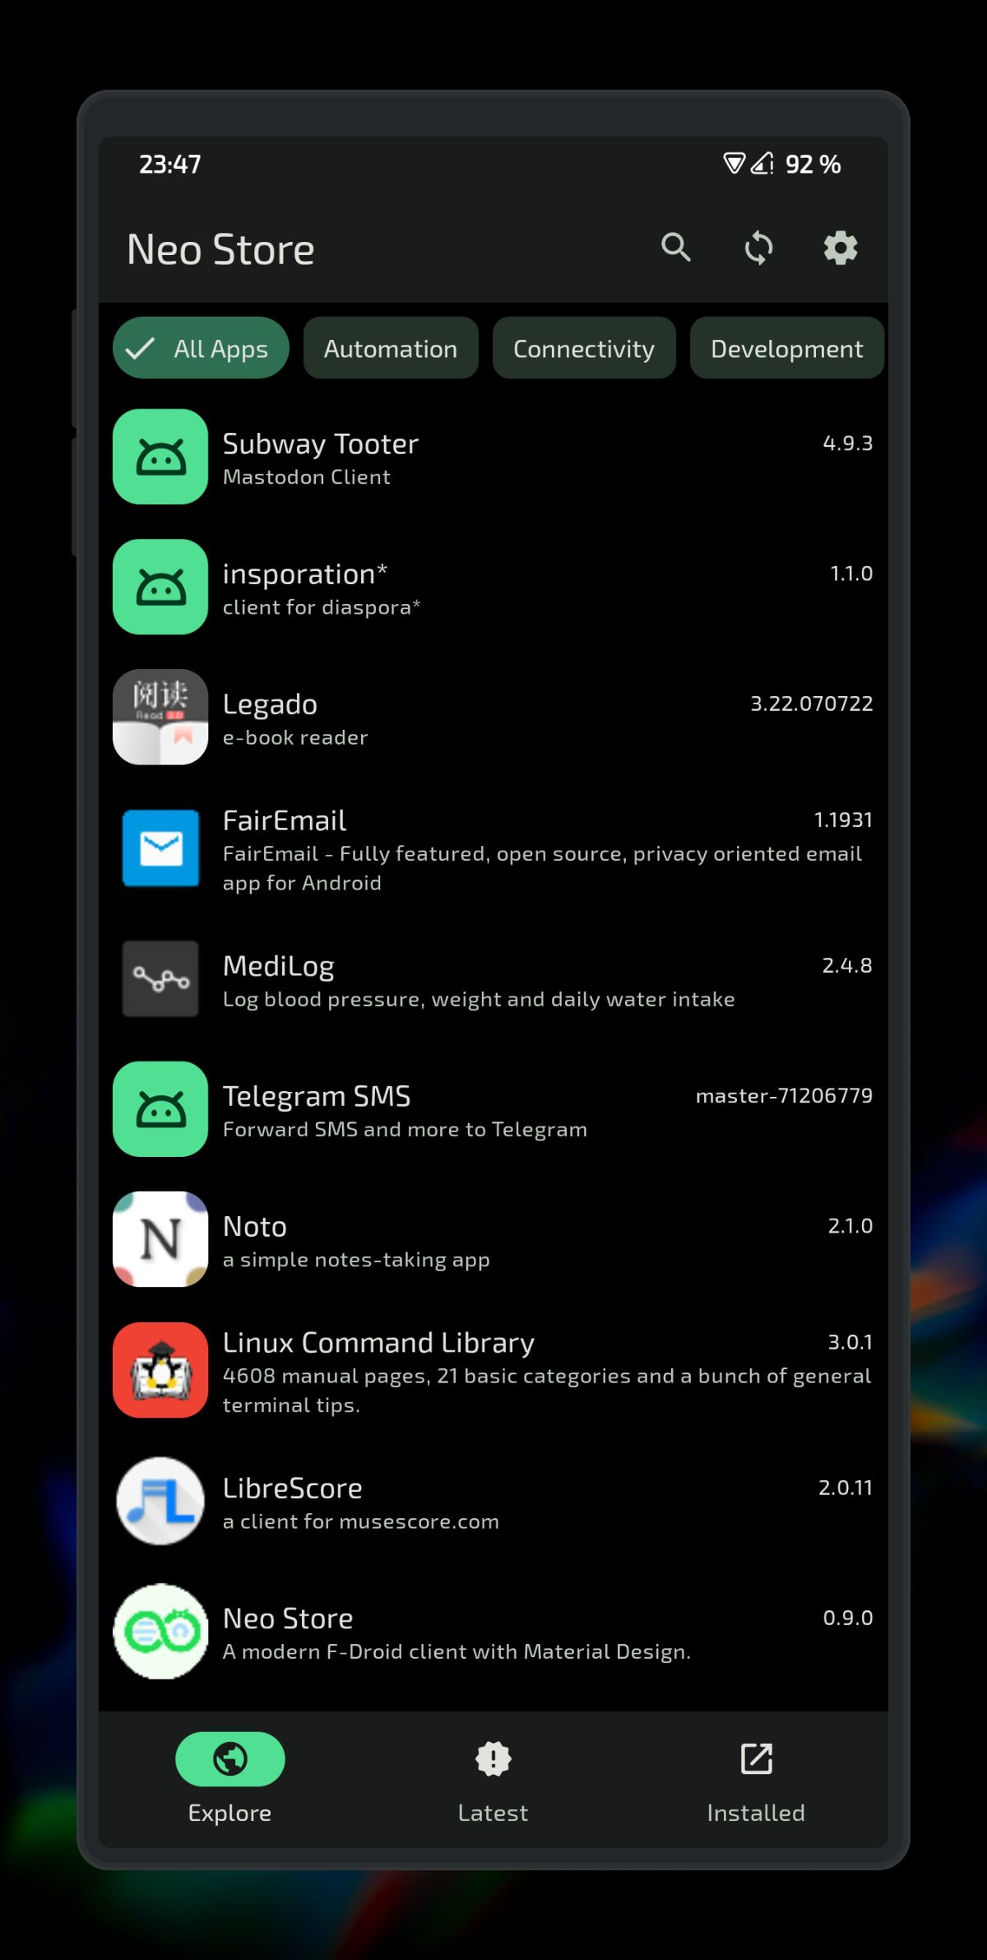
Open Technology Workshops
Other FOSS Alternatives
Operating Systems
Linux – more at the next Workshop!
Even Phone and Tablet Apps!
Android
F-Droid store
https://f-droid.org
Neo Store
https://github.com/NeoApplications/Neo-Store
iOS
https://github.com/dkhamsing/open-source-ios-apps

Slide 8
Open Technology Workshops
Where to find more
Lists
https://www.opensourcealternative.to
https://opensourcealternatives.org
It's FOSS (itsfoss.com)
https://www.privacyguides.org/
https://opensource.builders
https://switching.software
https://alternativeto.net/
Getting Involved
https://github.com/cornelius/awesome-open-source - A curated list of resources related to how to do open source projects
Thank you for coming!

